Slide 1


Numerical Solutions to Differential Equations
Michael Richman
michael.s.richman@baesystems.com
x2179
16 September 2008

Slide 2



Numerical Solutions to Differential Equations
First order:
Second order:
n^{th} order:
Also, system of differential equations, partial differential equations.
We will cover:
  Simple numerical integration
  Differential equations
  System description
  Accuracy

Slide 3
Motivation
Why not solve analytically?
  Closed form solution not always possible
  Even if possible, might be overkill
  Can be the only way to handle certain equations or systems of equations

Slide 4


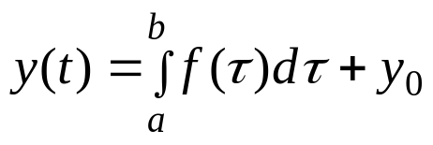
Numerical Integration: Problem Setup
Basic problem: On interval [a,b], solve
for y(t) subject to initial condition
Solution:
If y₀ = 0, then the solution corresponds to the area under the curve
f(t)
a
b
t

Slide 5
Numerical Integration: How well can we do?
Assume f(b) = f(a):
If we take smaller steps, that might be good enough:
f(t)
a
b
t
f(t)
a
b
t

Slide 6
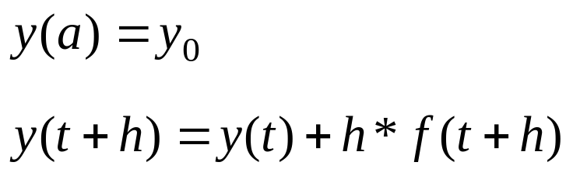
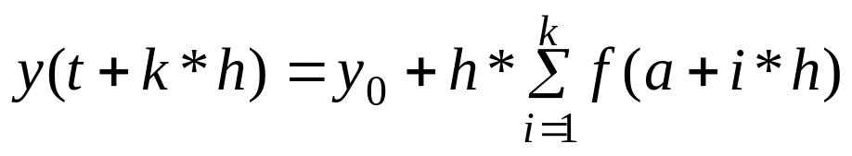
Numerical Integration: Euler formula
Assume that f(t) is constant over step size h
This is a 0th order polynomial approximation i.e. f(t) = c
Initial condition:
At each step:
For k steps:

Slide 7
Numerical Integration: Euler formula (cont)
Could choose end of step interval or midpoint to select rectangle height:
Requirements of Euler method:
  Need small step size h
  Requires y₀, f(a+i*h) for all i
May not be accurate enough
f(t)
f(t)
a
b
t
a
b
t

Slide 8
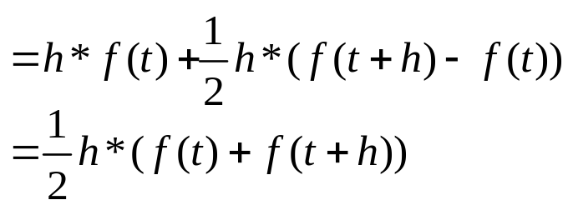
Numerical Integration: Trapezoidal rule
Approximate f(t) by a line over the step size interval:
Area of trapezoid = Area of rectangle plus area of triangle
f(t)
a
b
t

Slide 9
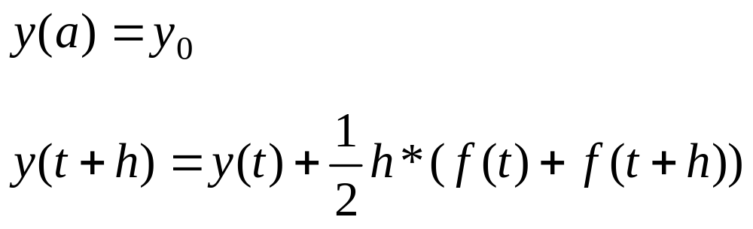
Numerical Integration: Trapezoidal rule (cont)
Initial condition:
At each step:
Introduce notation: f₀ = f(a), f₁ = f(a+h), f_{k}= f(a + k*h)
Similarly, y₀ = y(a), y₁ = y(a+h), y_{k}=f(a+k*h)

Slide 10
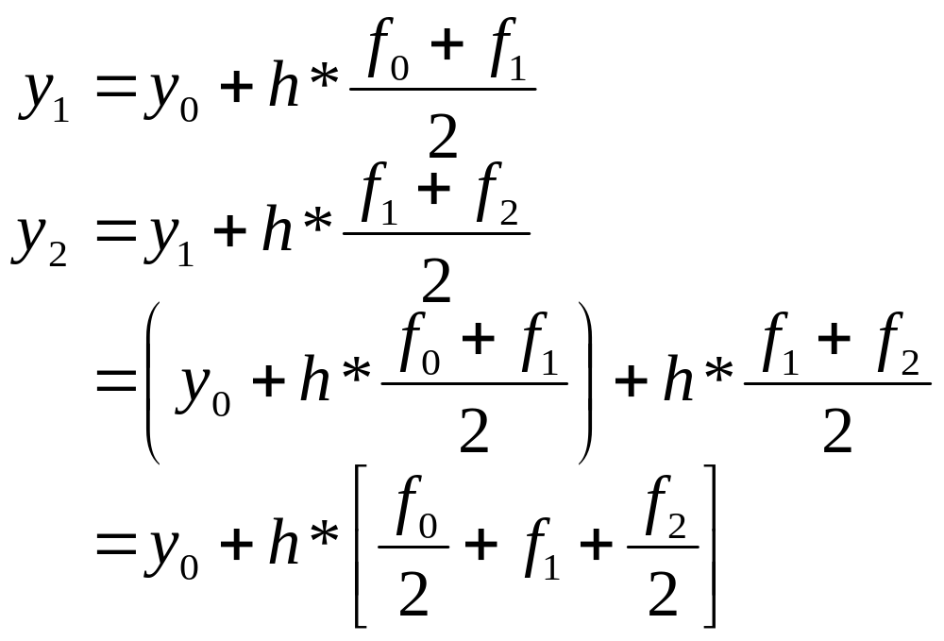
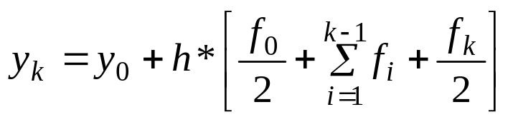
Numerical Integration: Trapezoidal rule (cont)
Iterating from the initial condition:
Thus,

Slide 11
Numerical Integration: Trapezoidal rule (cont)
Method uses a straight line (1st order approximation) to approximate f(t)
What if the slope of f(t) changes substantially?
  Will get significant errors or
  Choose very small step size h
    requires more computation

Slide 12
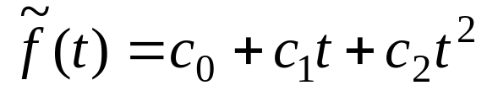
Numerical integration: Simpson’s rule
Fit f(t) to a 2nd order polynomial on the step size interval
Approximate by
What is the area underneath the quadratic?
f(t)
t_{i}
t_{i} +2h
t

Slide 13
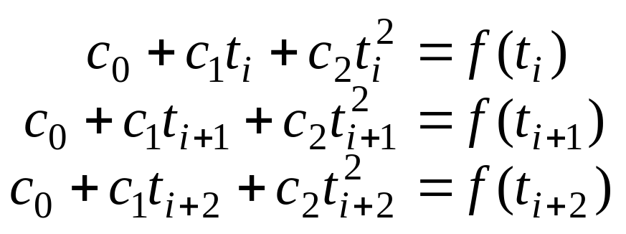
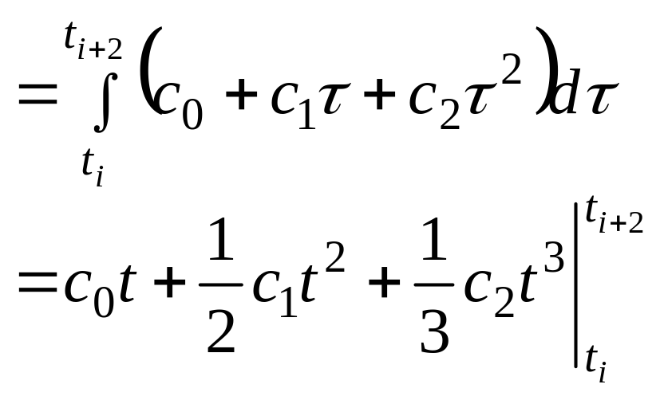
Numerical Integration: Simpson’s rule (cont)
First, solve for quadratic coefficients:
Then solve for area:

Slide 14
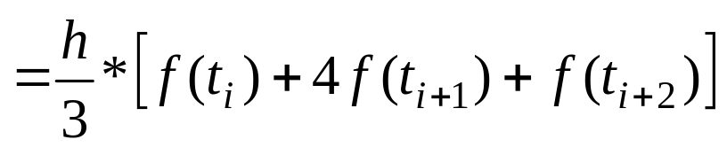
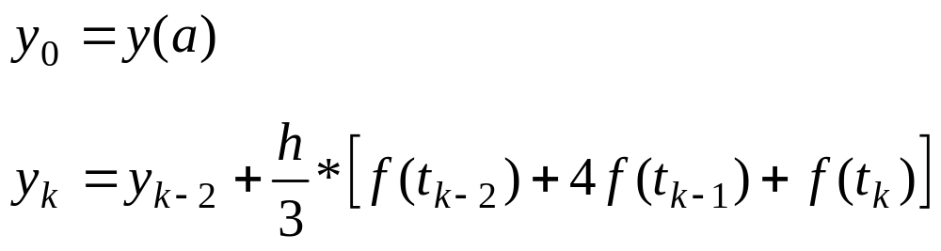
Numerical Integration: Simpson’s rule
After you solve for coefficients and plug into area formula:
Area
Initial condition:
At each step:
With this form, only even indices can be computed.

Slide 15
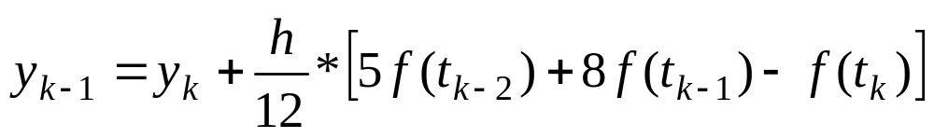
Numerical Integration: Simpson’s rule
Further algebra leads to formula for odd samples:
Compute 2 intervals at once
Can use larger step size h than previous methods with comparable accuracy

Slide 16
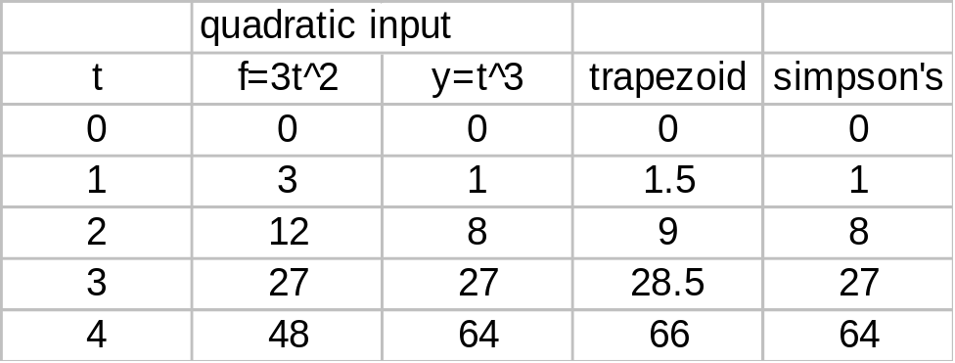
Numerical Integration: Example
Choose f(t) = 3t², initial condition y(0) = 0, step size h=1
Note: while trapezoid rule is worse, we could improve its performance in this case by decreasing the step size

Slide 17
Differential Equations:
First order:
Second order:
n^{th} order:
Not all equations are solved by the direct integration of some function (or samples of a function).
Instead, the derivative of a function can be dependent on the function itself

Slide 18
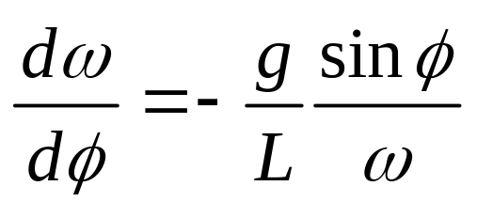
Differential Equations: Example
Simple pendulum
Calculate angular velocity ω as a function of φ
Initial condition: ω(φ₀) = ω₀
L
g
φ
m

Slide 19
Differential Equations: Basic Approach
Given equation: y’(t) = f(t,y(t))
and initial condition: y(0) = y₀
Solution will be of the form: y(t+h) = y(t) + Δy
This is similar to how we solved the numerical integration problem
Think extrapolation

Slide 20
Differential Equations: Euler’s method
Use value of derivative (slope) at one time to linearly extrapolate the value of the function at the next time
y(t_{i}+h) = y(t_{i}) + h*f(t_{i},y(t_{i}))
y(t_{i}+h)
slope
f(t_{i},y(t_{i}))
y(t_{i})
t_{i}
t_{i} + h
t

Slide 21
Differential Equations: Example
y’(t) = 2y(t) + sin3t
y₀ = 1
Let h = 0.01
y(0.01) = y(0) + [2*y(0) + sin(0)](0.01) = 1.02
y(0.02) = 1.02 + [2*1.02 + sin(0.03)](0.01) = 1.0407
y(0.03) = ...

Slide 22
Differential Equations: Pendulum
Solve for angular velocity as a function of position:
ω₀ = 0.01, φ₀ = 0.5
For Δφ = 0.1, evalute ω(φ) (assume g/L = 1):
ω(0.5) = 0.01
ω(0.6) = 0.01 - (0.1)sin(0.5)/0.01 = 0.01 - 10sin(0.5)
ω(0.7) = ω(0.6) - (0.1)sin(0.6)/ω(0.6)

Slide 23
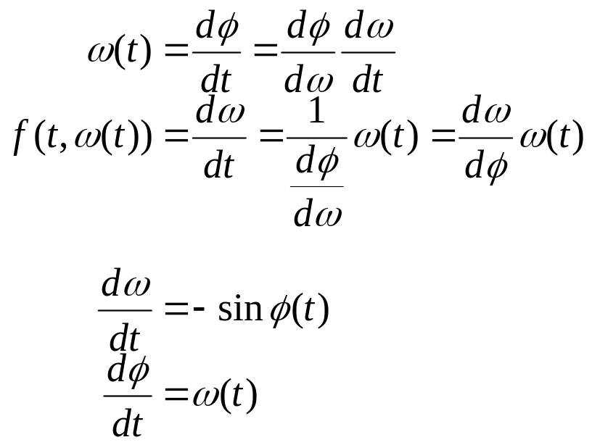
Differential Equations: Further Example
Suppose we want to know angular position and velocity as a function of time: e.g. ω and φ are functions of t
Same initial conditions as previous example: ω₀ = 0.01, φ₀ = 0.5
Note that

Slide 24
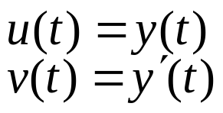
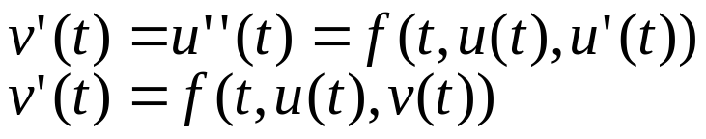

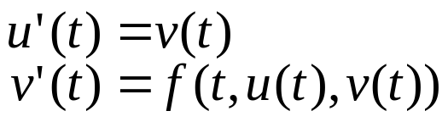
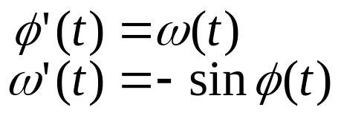
Differential Equations: Reducing a 2nd Order Equation to a System of Two 1st Order Equations
Given , we can reduce this to a system of first order equations by defining:
By substitution, we get:
Thus, the 2nd order differential equation for is equivalent to the system:
In the previous example:

Slide 25
Differential Equations: Solving a system
There are 2 equations to solve: we must solve them simultaneously!
Initial condition: f(0) = -sin(φ(0))= -sin(0.5)
ω(h) = ω(0) + h*f(0)
φ(h) = φ(0) + h*ω(0)
Then, f(h) = -sin(φ(h))
ω(2h) = ω(h) + h*f(h)
φ(2h) = φ(h) + h*ω(h)

Slide 26
Differential Equations: Solving a system
And,
ω((k+1)h) = ω(kh) + h*sin(φ(kh))
φ((k+1)h) = φ(kh) + h*ω(kh)
Can we improve upon this approach?

Slide 27
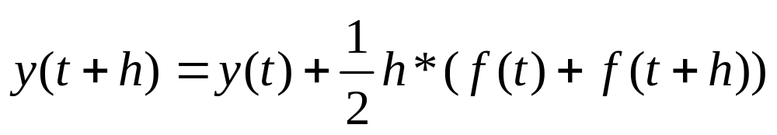
Differential equations: Trapezoidal rule?
We improved the Euler method for numerical integration using either trapezoidal rule or Simpson’s rule - apply similar concepts for solving differential equations
Is there a trapezoidal rule for differential equations?
  Recall numerical integration:
  Why can’t we apply this concept directly?

Slide 28
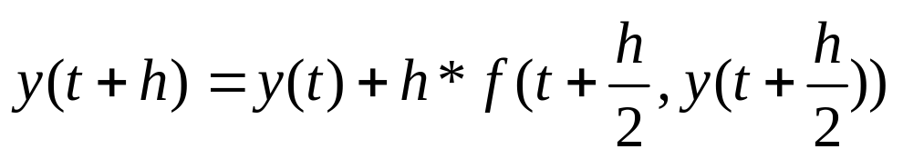
Differential Equations: Modified Euler method
Do Euler method to estimate y at the midpoint y(t+h/2)
Using that estimate, estimate the derivative at the midpoint f(t+h/2,y(t+h/2))
Compute y(t+h) using this slope
2nd order method

Slide 29
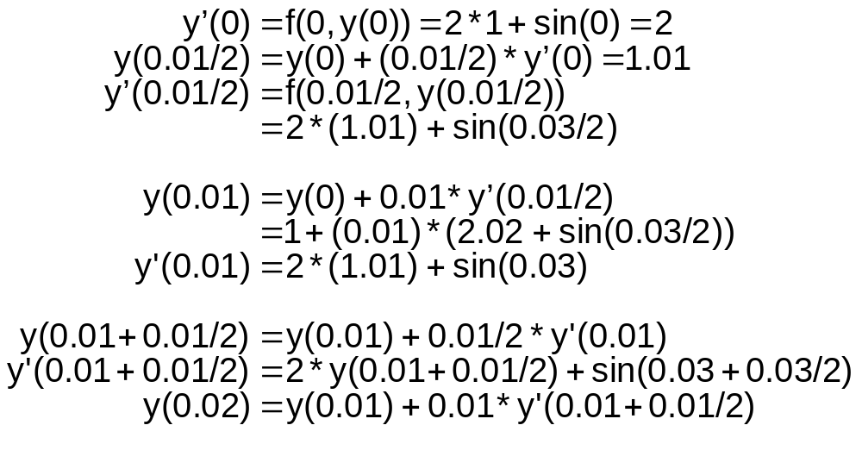
Differential Equations: Modified Euler example
y(0) = 1
y’(0) = 2y(t) + sin(3t)
h = 0.01

Slide 30
Differential Equations: Runge-Kutta methods
Runge-Kutta methods are designed to approximate Taylor series methods
They do not require explicit evaluations of the derivatives of f(t,y(t))
The basic idea is to use a linear combination of values of f(t,y(t)) to approximate y(t) at selected points
This linear combination is matched up as closely as possibly with a Taylor series for y(t)
The order of the method is determined by the order of the Taylor series approximation

Slide 31



Differential Equations: Runge-Kutta methods
2nd order Runge-Kutta method with weighted slope
Recall
Compute a linear estimate of y(t+h) as per Euler method
Obtain additional information:
  using linear estimate, estimate slope at t+h

Slide 32
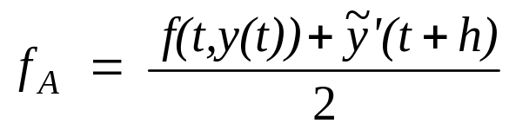
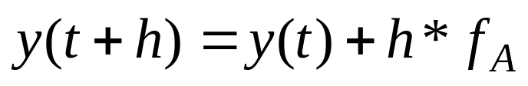
Differential Equations: 2nd order Runge-Kutta
Calculate the average slope
Use this slope to calculate the next step
Euler step
f_{A}
est. slope
y(t_{i})
init. slope
t_{i}
t_{i} + h
t

Slide 33
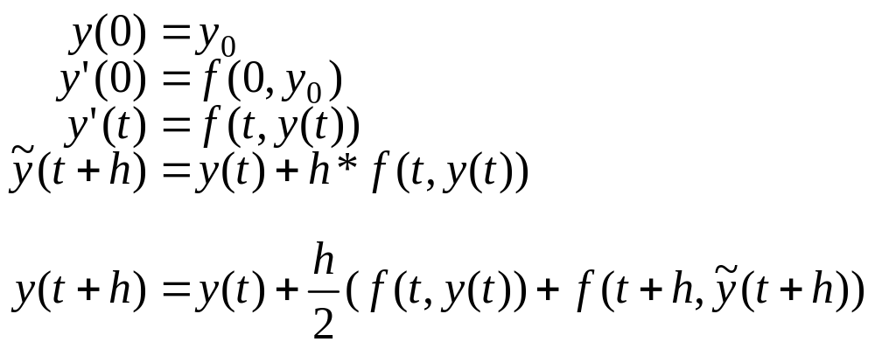
Differential Equations: 2nd order R-K summary

Slide 34
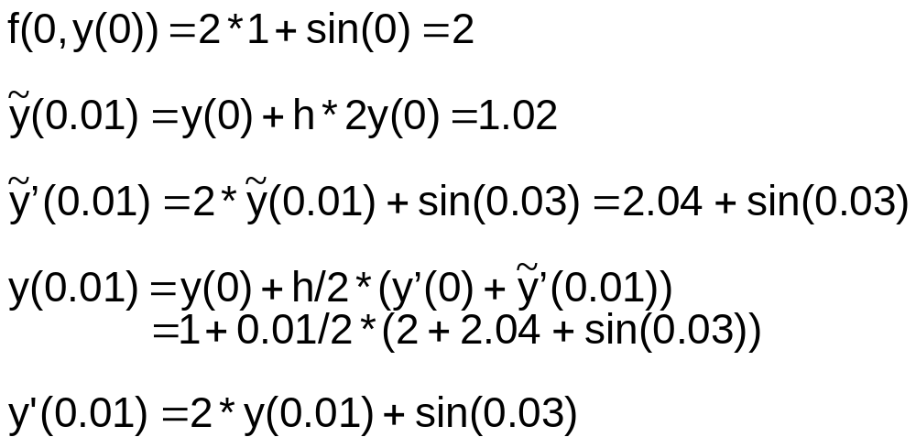
Differential Equations: 2nd order R-K example
y(0) = 1
y’(0) = 2y(t) + sin(3t)
h = 0.01

Slide 35
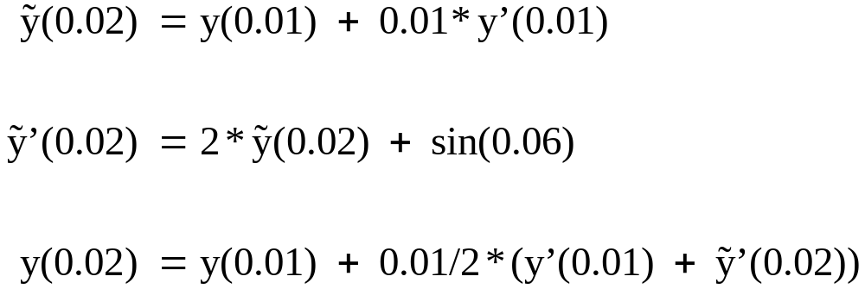
Differential Equations: Example (cont)
When you compare the initial estimate to the final estimate, note that the difference is proportional to h² = (0.01)²
Both 2nd order methods are comparable in accuracy
Both 2nd order methods are superior to Euler’s method

Slide 36
Differential Equations: Other considerations
Modified Euler method requires that the derivative be evaluated at each midpoint
2nd order Runge-Kutta requires the derivative to be evaluated at each step only (not in the middle)
If midpoints of the step interval were not available, some form of interpolation would be required
Computational issue: sometimes it is desirable to minimize the number of times a function is computed (due to the processor load) - for some applications this can be even more important than accuracy

Slide 37
Differential Equations: 4th order Runge-Kutta
Use a combination of midpoints and weighted slopes to improve accuracy
Estimate behavior at midpoint and use relationships between y and y’ to extrapolate
e.g. y’(t) = f(t,y(t)) y(t+h) = y(t) + h*w
w is a weighted slope, a linear combination of 4 other slopes:
      w = μ ₁s₁ + μ ₂s₂ + μ ₃s₃ + μ ₄s₄
how are weights μ _{i} and slopes s_{i} are chosen?

Slide 38
Differential Equations: 4th order R-K slopes
~
y(t_{i}+h)
est. slope s₄
y(t_{i}+h)
y_{m2}
est. slope s₃
y_{m1}
est. slope s₂
y(t_{i})
slope
s₁
t_{i}
t
t_{i} + h/2
t_{i} + h

Slide 39
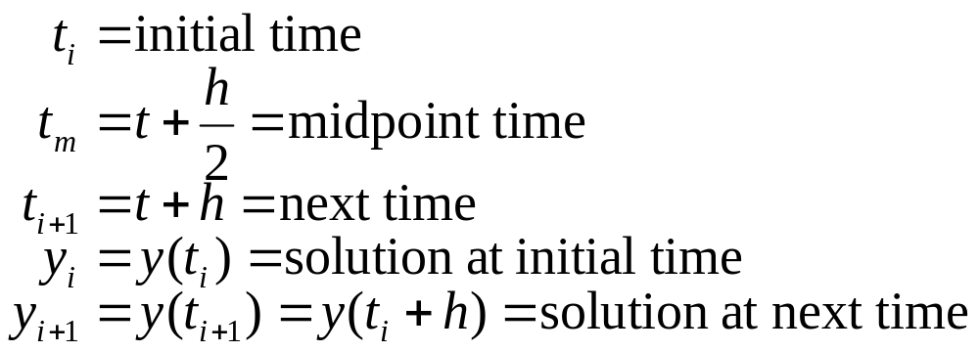
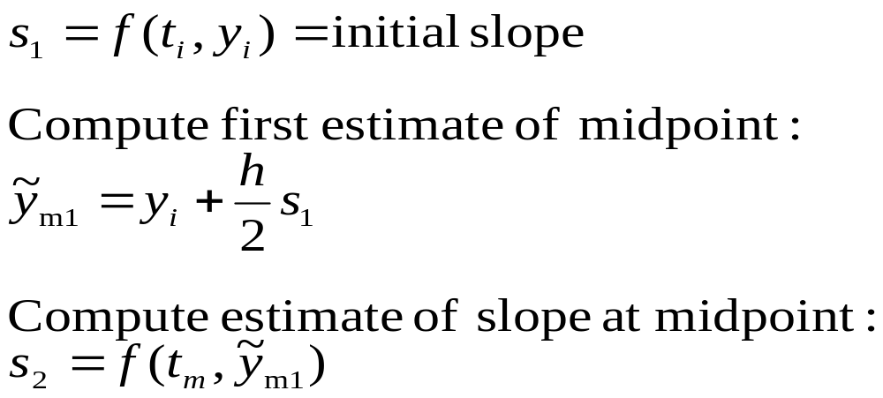
Differential Equations: Determination of slopes
Definitions:
Derivation:

Slide 40
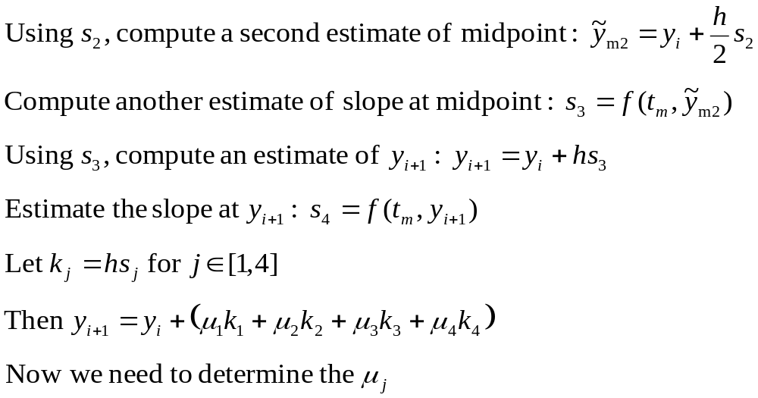
Differential Equations: 4th order R-K slopes (cont)

Slide 41
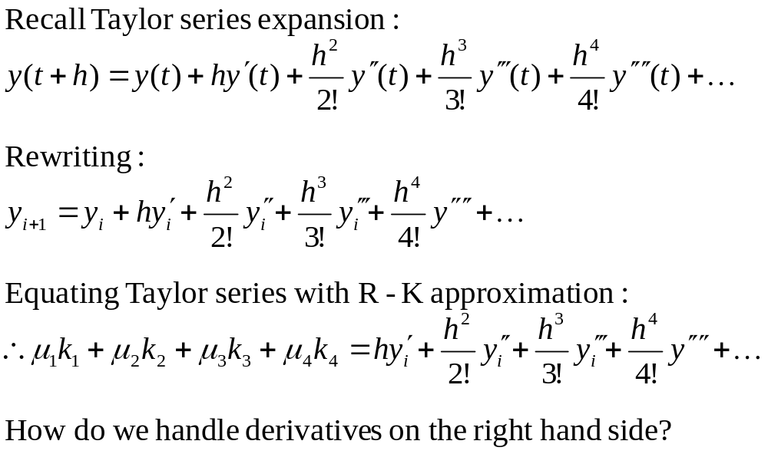
Differential Equations: Determination of weights

Slide 42
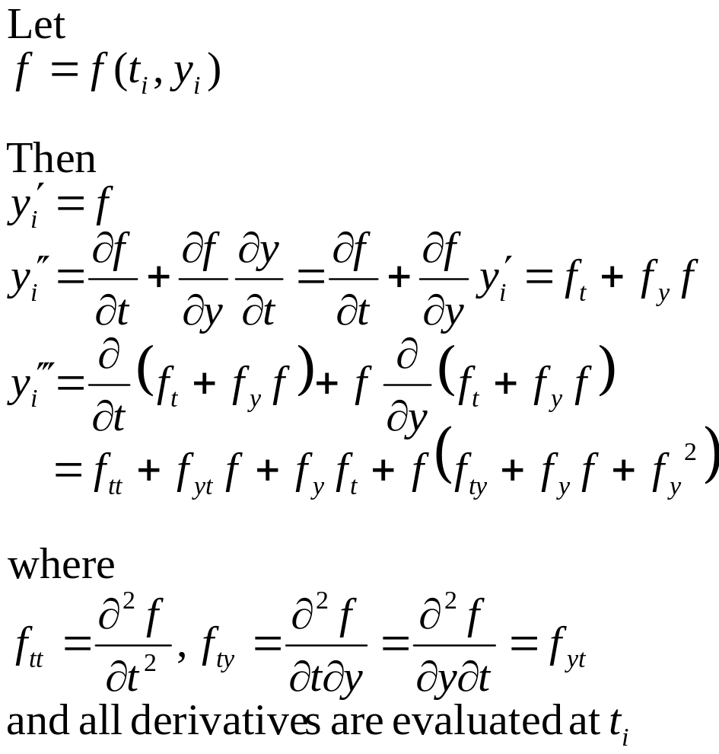
Differential Equations: R-K weights (cont)

Slide 43
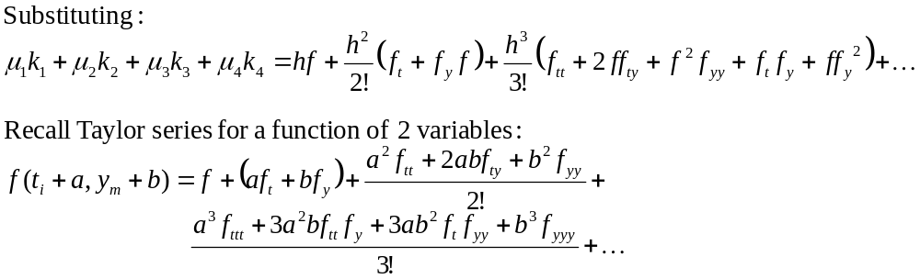
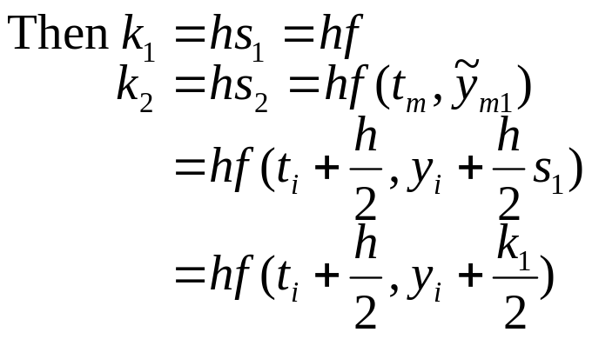
Differential Equations: R-K weights (cont)

Slide 44
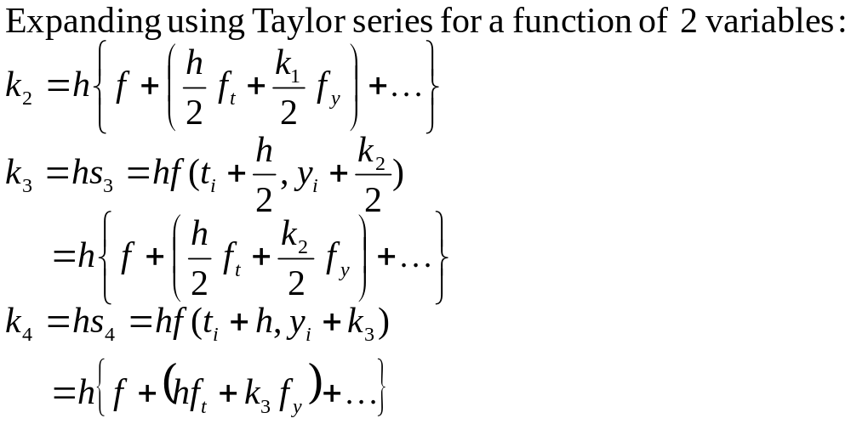
Differential Equations: R-K weights (cont)

Slide 45
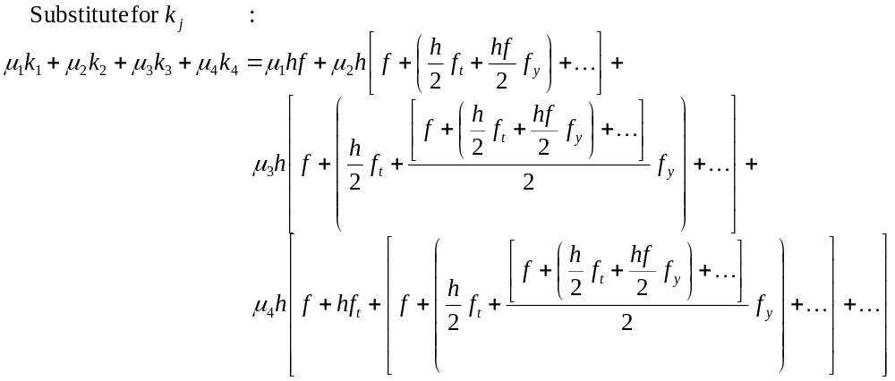
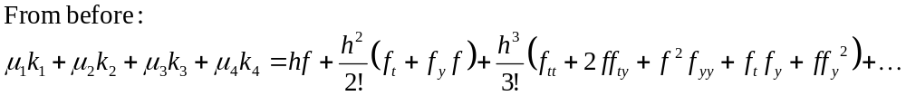
Differential Equations: R-K weights (cont)

Slide 46
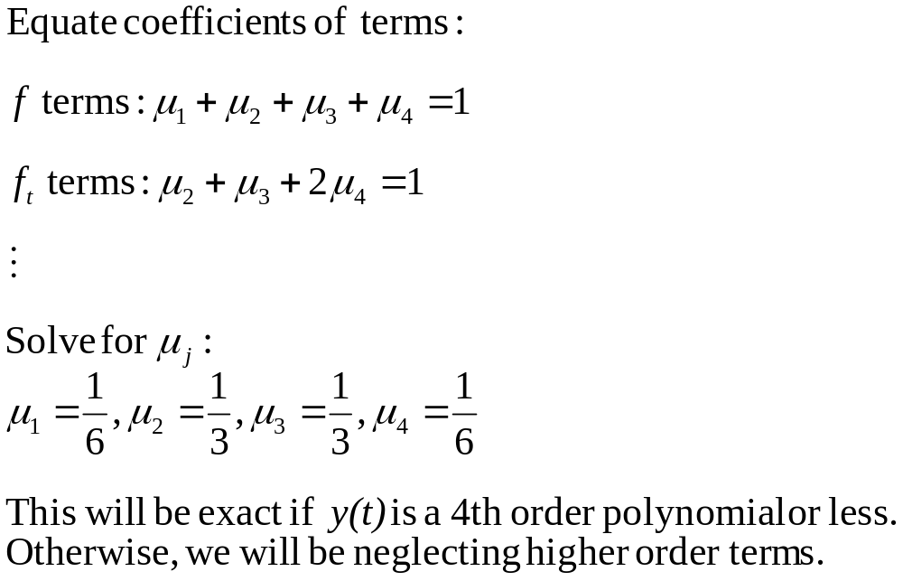
Differential Equations: R-K weights (cont)

Slide 47
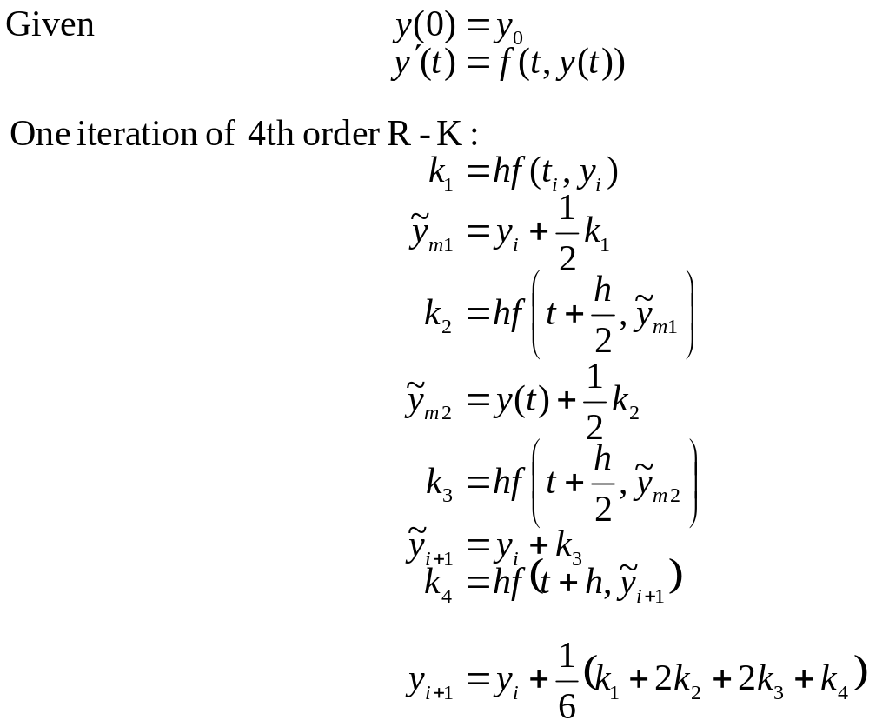
Differential Equations: 4th order R-K iteration

Slide 48
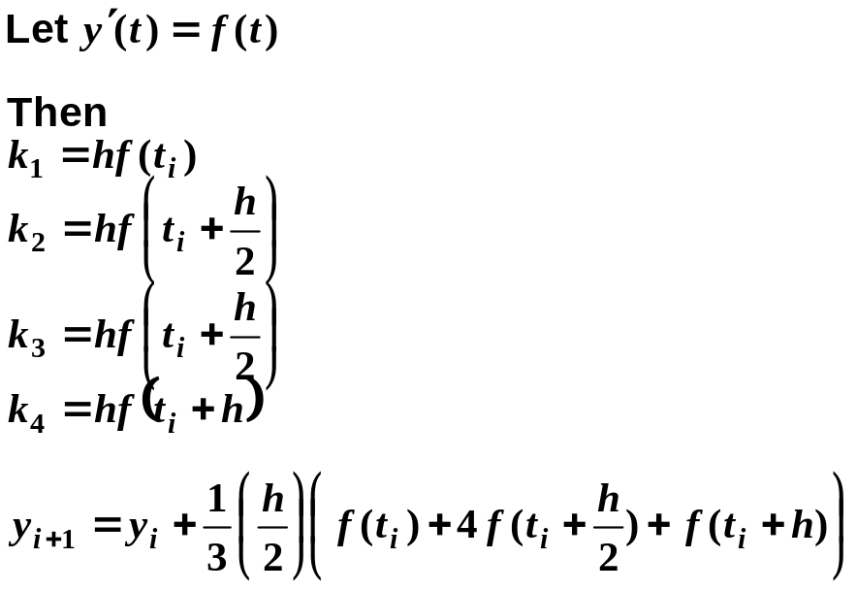
Differential Equations: 4th order R-K summary
This is exact if y(t) is a 4th order polynomial or less
There are other combinations of coefficients and intermediate points that can be used
With a 4th order Runge-Kutta method, a step size h can be 50 times larger than that of the Euler method and will still be more accurate
Observation:
Simpson’s rule

Slide 49
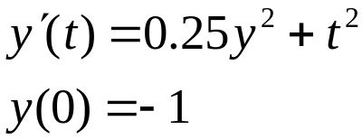
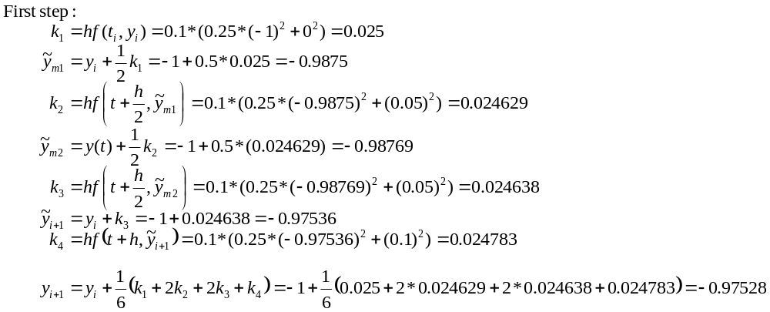
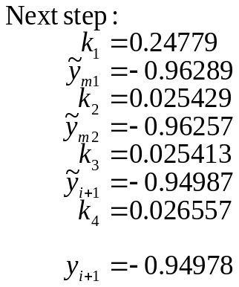
Differential Equations: R-K example
Solve
with initial condition
Choose stepsize h=0.1

Slide 50
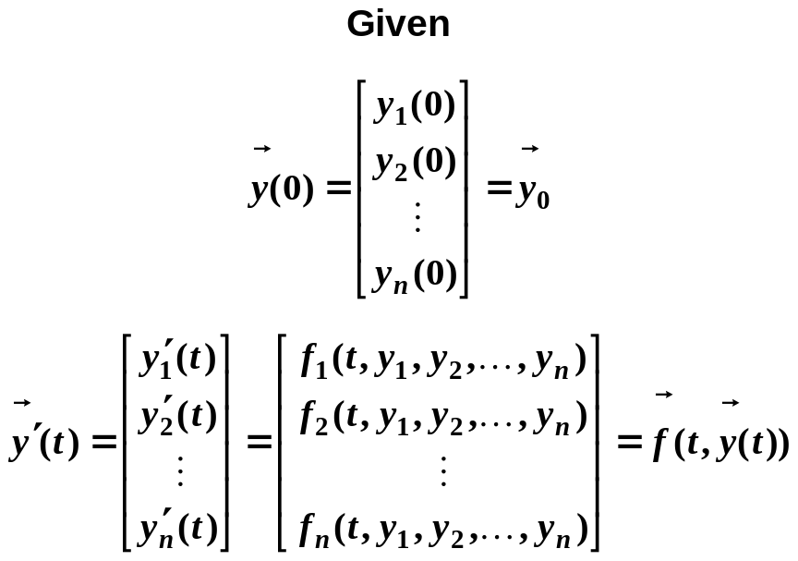
Differential Equations: Extension to Sys of Eqs
There is a straightforward extension of the already described methods for systems with more than one integrator
Also can be applied to higher-order differential equations, which may be reduced to a system of 1st order equations (see page 23)
Just express in “vector form” and apply the same methods:

Slide 51
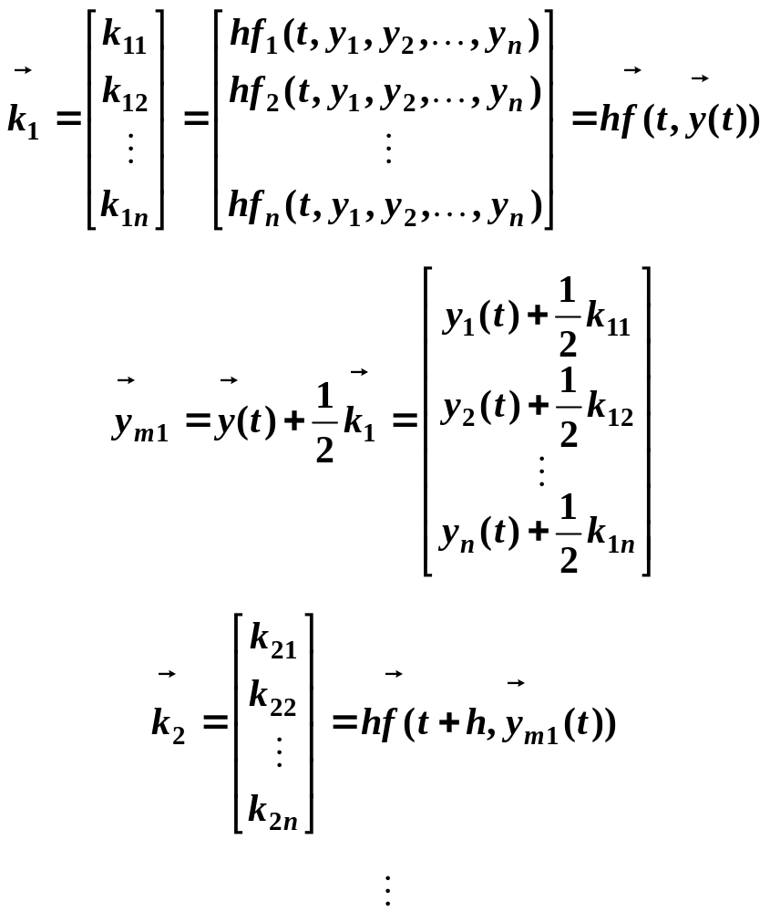
Differential Equations: Extension to Sys of Eqs
Vector form of 4th order Runge-Kutta:

Slide 52
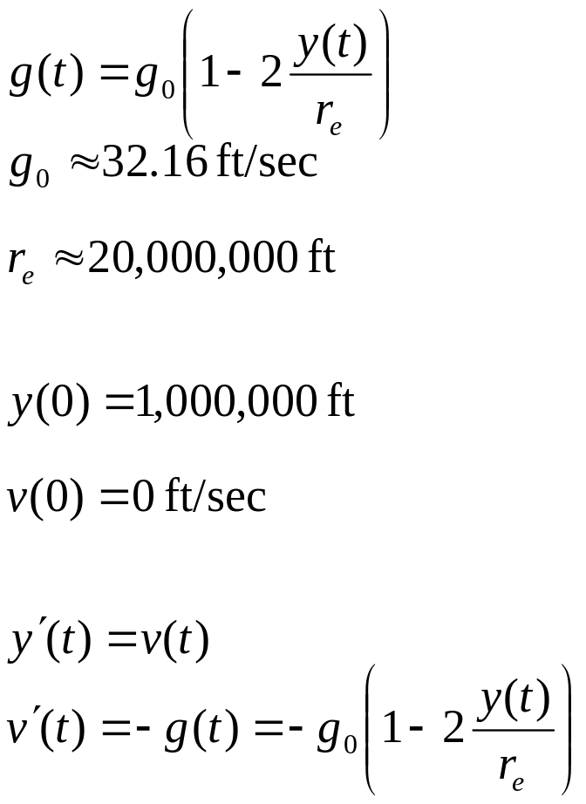
Differential Equations: R-K system example
Describe the motion of a bowling ball dropped from an altitude of 1,000,000 ft. Neglect aerodynamic effects, but consider the variation of gravity with altitude.
Gravity model:
g(t)
y(t)
Initial conditions:
Equations of motion:

Slide 53
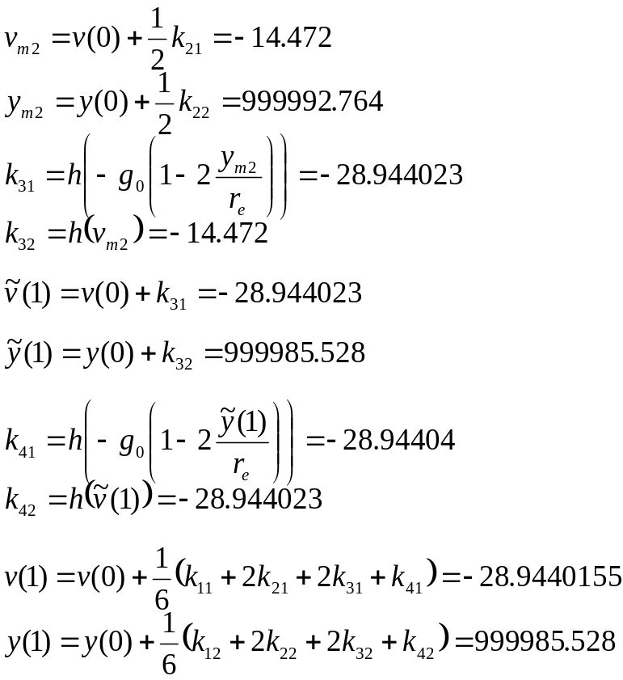
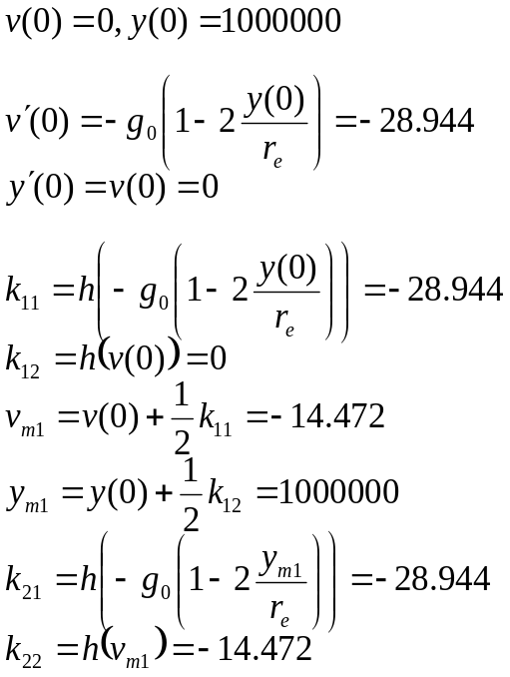
Differential Equations: R-K system example (cont)
Let step size h = 1 sec

Slide 54

Differential Equations: Predictor-Corrector
Philosophy: an iterative approach
Using some method, estimate y(t+h)
Then use this to estimate v(t+h)
Using this v(t+h) and v(t), obtain a new estimate of y(t+h).
If the new y(t+h) is close enough to the previous estimate of y(t+h), go to the next interval
Otherwise, repeat the process

Slide 55
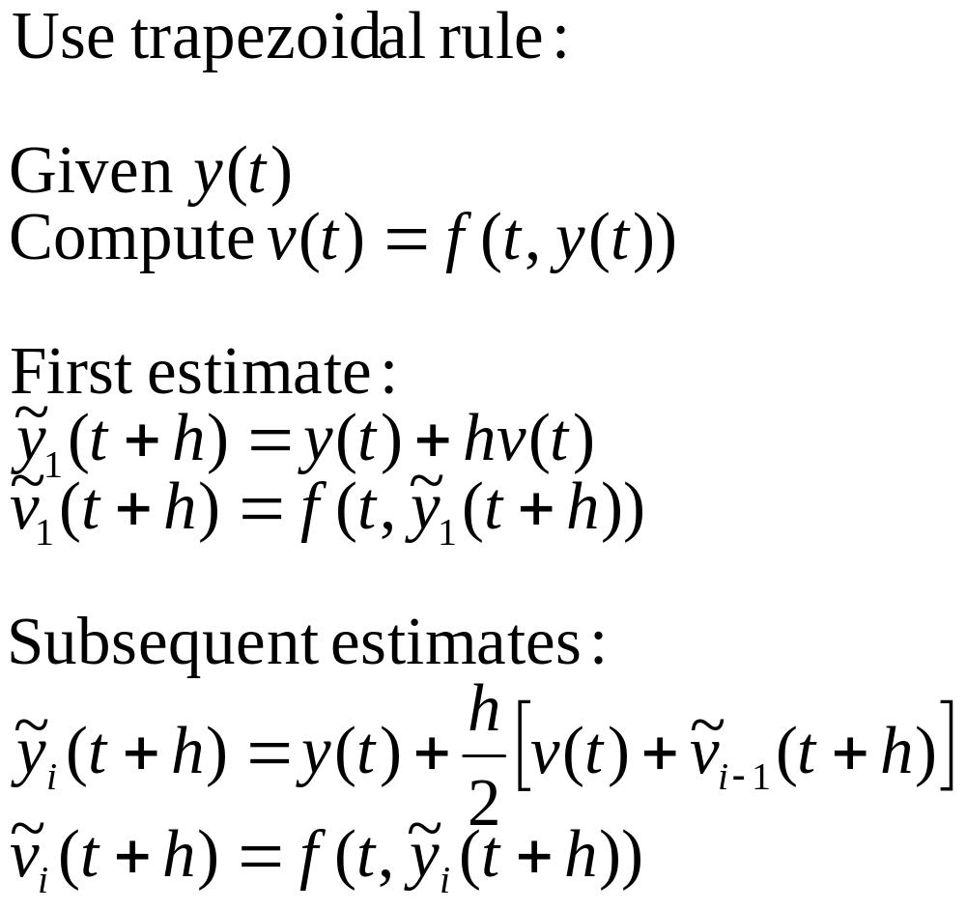
Differential Equations: P-C example

Slide 56


Differential Equations: P-C example (flow chart)
N
Y

Slide 57
Differential Equations: Accuracy of methods
Truncation errors
  Any nth order method uses Taylor series up to the nth power
  Errors come mainly from the (n+1)th power of the Taylor series
  1st order methods have errors proportional to h² (referred to as O(h²))
  2nd order methods are O(h³)
  4th order methods are O(h⁴)
  Remember, if y(t) is an nth order polynomial, then there are no additional terms in the Taylor series and an nth order method will provide an exact solution

Slide 58
Differential Equations: Accuracy of methods
Effect of step size h on accuracy
  h too large produces “instability”
    instability means that the computed solution for y(t) will diverge from the true solution
  h too small produces excessive roundoff errors
    there is also an additional computational burden
  Choice of h might depend on input function
    there is no hard and fast rule for a particular method
  Experiment with different sizes for a few points and see what happens

Slide 59




Differential Equations: Accuracy example
Single spring:
Analytical solution:
Euler
RK
Figure obtained from http://farside.ph.utexas.edu/teaching/329/lectures/node65.html

